Slide 1
DATA SCIENCE machine learning

Slide 2
I. what is machine learning? iI. Supervised Learning III. Unsupervised Learning
agenda

Slide 3
I. What is machine learning?
MACHINE LEARNING

Slide 4
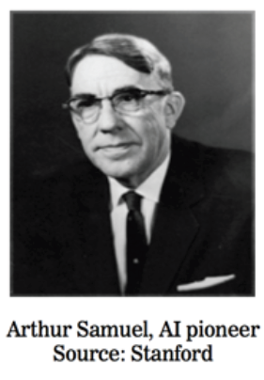
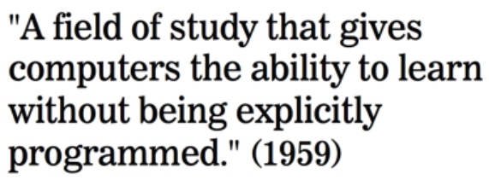
What is machine learning?

Slide 5

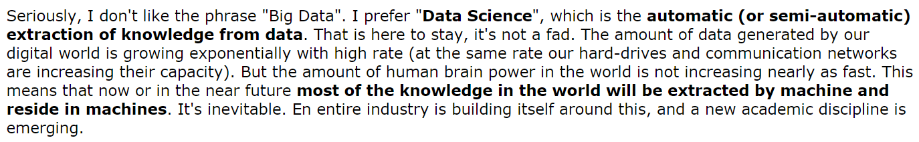
What is machine learning?
Source: http://www.reddit.com/r/MachineLearning/comments/25lnbt/ama_yann_lecun

Slide 6
What is Machine Learning?
One definition: “Machine learning is the semi-automatic extraction of knowledge from data.”
Knowledge from data: Starts with a question that might be answerable using data
Automatic extraction: A computer provides the insight
Semi-automatic: Requires many smart decisions by a human

Slide 7
II. Supervised Learning
MACHINE LEARNING

Slide 8
Types of Machine Learning
There are two main categories of machine learning: supervised learning and unsupervised learning.
Supervised learning (aka “predictive modeling”):
Predict an outcome based on input data
Example: predict whether an email is spam or ham
Goal is “generalization”

Slide 9
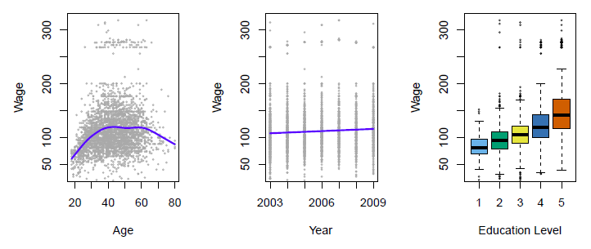
Supervised Learning
Predict salary using demographic data
Income survey data for males from the central Atlantic region of the USA in 2009
Source: https://class.stanford.edu/c4x/HumanitiesScience/StatLearning/asset/introduction.pdf

Slide 10
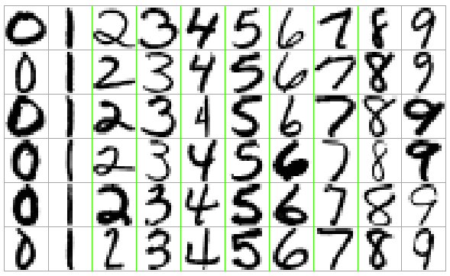
Supervised Learning
Identify the numbers in a handwritten zip code
Source: https://class.stanford.edu/c4x/HumanitiesScience/StatLearning/asset/introduction.pdf

Slide 11
Supervised Learning
There are two categories of supervised learning:
Regression
Outcome we are trying to predict is continuous
Examples: price, blood pressure
Classification
Outcome we are trying to predict is categorical (values in a finite set)
Examples: spam/ham, cancer class of tissue sample

Slide 12
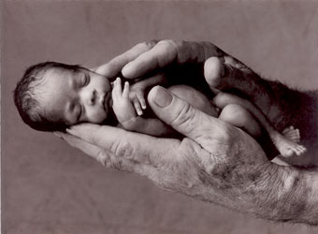
Regression or Classification?
Problem: Children born prematurely are at high risk of developing infections, many of which are not detected until after the baby is sick
Goal: Detect subtle patterns in the data that predicts infection before it occurs
Data: 16 vital signs such as heart rate, respiration rate, blood pressure, etc…
Impact: Model is able to predict the onset of infection 24 hours before the traditional symptoms of infection appear
Image: http://www.babycaretips4u.com/wp-content/uploads/2014/03/premature-baby.jpg
Case Study: http://www.amazon.com/Big-Data-Revolution-Transform-Think/dp/0544002695

Slide 13

Regression or Classification?

Slide 14
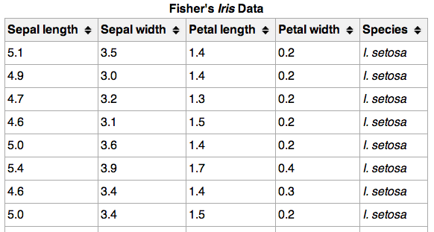
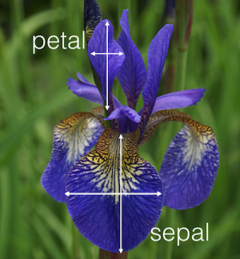
Regression or Classification?

Slide 15
Machine Learning Terminology
}
{
150 observations
(n = 150)
Feature matrix “X” has n rows and p columns
Response “y” is a vector with length n
{
response
4 features (p = 4)

Slide 16
Machine Learning Terminology
Observations are also known as: samples, examples, instances, records
Features are also known as: predictors, independent variables, inputs, regressors, covariates, attributes
Response is also known as: outcome, label, target, dependent variable
Regression problems have a continuous response. Classification problems have a categorical response. The type of supervised learning problem has nothing to do with the features!

Slide 17
Supervised Learning
How does supervised learning “work”?
Train a machine learning model using labeled data
“Labeled data” is data with a response variable
“Machine learning model” learns the relationship between the features and the response
Make predictions on new data for which the response is unknown
The primary goal of supervised learning is to build a model that “generalizes”: It accurately predicts the future rather than the past!

Slide 18
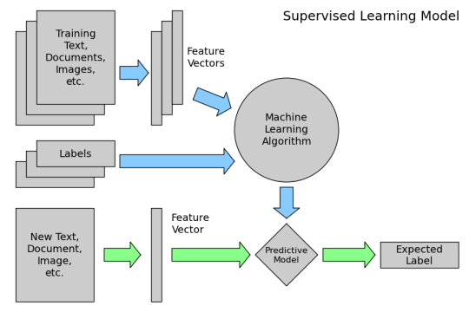
Supervised Learning
How does supervised learning “work”?

Slide 19
Supervised Learning
Supervised learning example: Coin classifier
Observations: Coins
Features: Size and mass
Response: Coin type, hand-labeled
Train a machine learning model using labeled data
Model learns the relationship between the features and the coin type
Make predictions on new data for which the response is unknown
Give it a new coin, predicts the coin type automatically

Slide 20
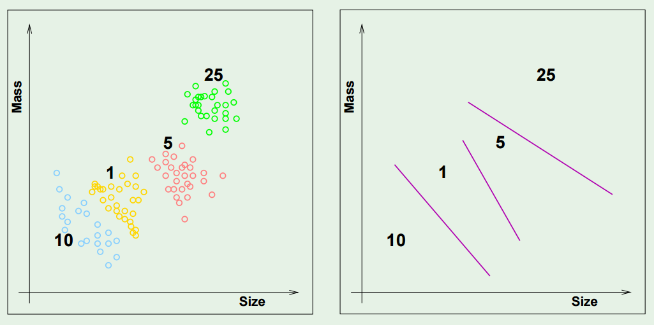
Supervised Learning

Slide 21
III. UNSupervised Learning
MACHINE LEARNING

Slide 22
Types of Machine Learning
There are two main categories of machine learning: supervised learning and unsupervised learning.
Unsupervised learning:
Extracting structure from data
Example: segment grocery store shoppers into “clusters” that exhibit similar behaviors
Goal is “representation”

Slide 23
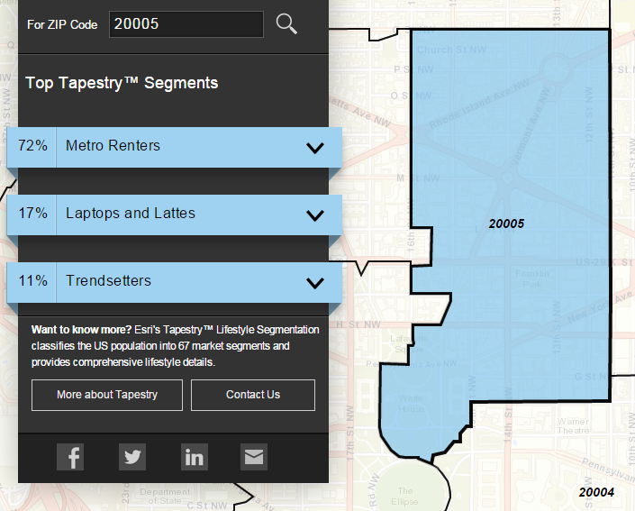
Unsupervised Learning
Group US residential neighborhoods into 67 unique segments based on demographic and socioeconomic characteristics
Metro Renters:
Young, mobile, educated, or still in school, we live alone or with a roommate in rented apartments or condos in the center of the city. Long hours and hard work don’t deter us; we’re willing to take risks to get to the top of our professions… We buy groceries at Whole Foods and Trader Joe’s and shop for clothes at Banana Republic, Nordstrom, and Gap. We practice yoga, go skiing, and attend Pilates sessions.
Source: http://www.esri.com/landing-pages/tapestry/

Slide 24
Unsupervised Learning
Common types of unsupervised learning:
Clustering: group “similar” data points together
Dimensionality Reduction: reduce the dimensionality of a dataset by extracting features that capture most of the variance in the data

Slide 25
Unsupervised Learning
Unsupervised learning has some clear differences from supervised learning. With unsupervised learning:
There is no clear objective
There is no “right anwser” (hard to tell how well you are doing)
There is no response variable, just observations with features
Labeled data is not required

Slide 26
Unsupervised Learning
Unsupervised learning example: Coin clustering
Observations: Coins
Features: Size and mass
Response: There isn’t one (no hand-labeling required!)
Perform unsupervised learning
Cluster the coins based on “similarity”
You’re done!
Sometimes, unsupervised learning is used as a “preprocessing” step for supervised learning. (How?)

Slide 27
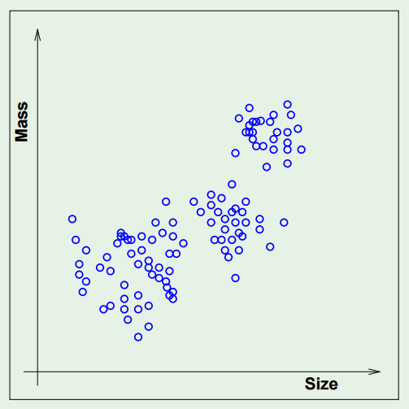
Unsupervised Learning

